Slide 1
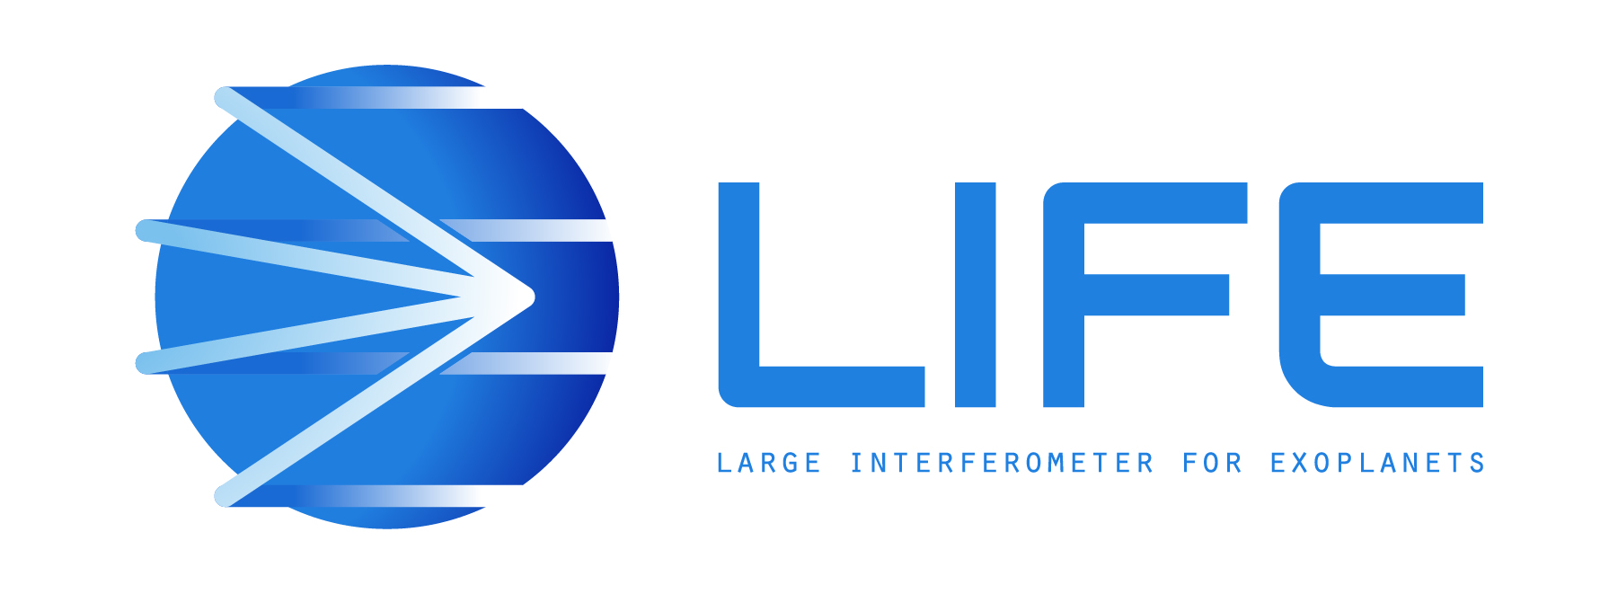






PUSHING EXOPLANET DETECTION CAPABILITY USING TUNABLE KERNEL-NULLING
Vincent Foriel^{1*}, Frantz Martinache¹, David Mary¹
Marc-Antoine Martinod¹, Nick Cvetojevic¹, Romain Laugier²
¹ Université Côte d'Azur, Observatoire de la Côte d'Azur, CNRS, Laboratoire Lagrange, France
² KU Leuven university, Leuven, Belgium * vincent.foriel@oca.eu

Slide 2
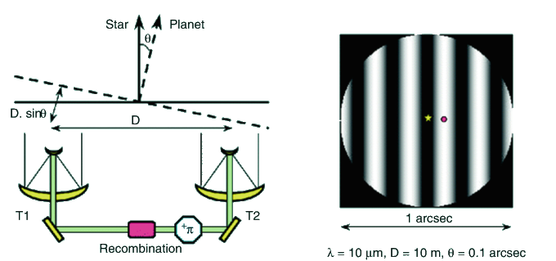
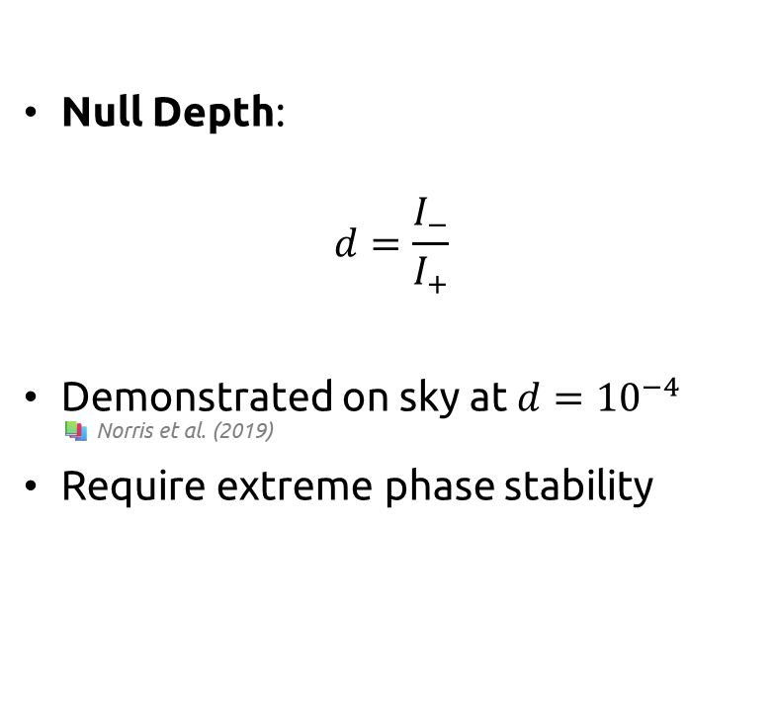
Nulling Interferometry
📚 Bracewell et al. (1978)
Null Depth:
$$d=\frac{I_{−}}{I_{+}}$$
Demonstrated on sky at $d={10}^{−4}$ 📚 Norris et al. (2019)
Require extreme phase stability
📚 D. Rouan (2022)
Vincent Foriel – WITSO 2025
Notes:
Success of such approch rely on extreme phase stability Not the case for 2 reasons (upstream + intrasic)
Null Depth always contain starlight leakage -> hard to distinguish planet signal
To reduce upstream phase sensitivity & have a more robust observable -> Kernel-Nulling

Slide 3
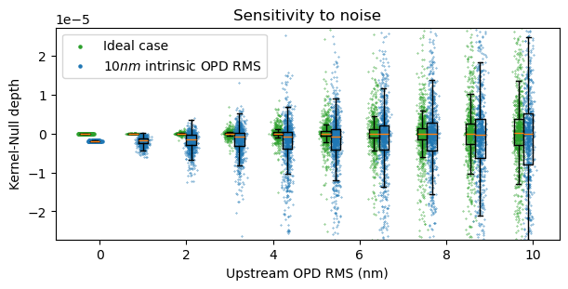
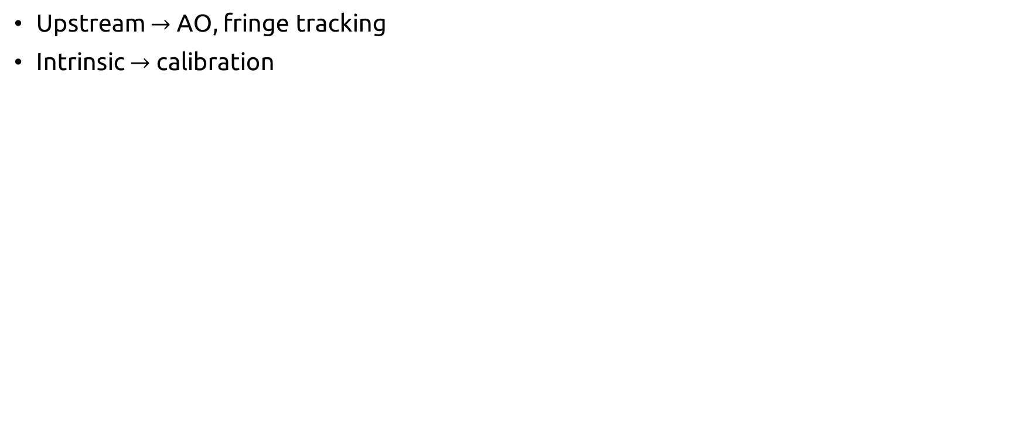
Noise sources
Upstream $→$ AO, fringe tracking
Intrinsic $→$ calibration
Vincent Foriel – LIFE 2025

Slide 4
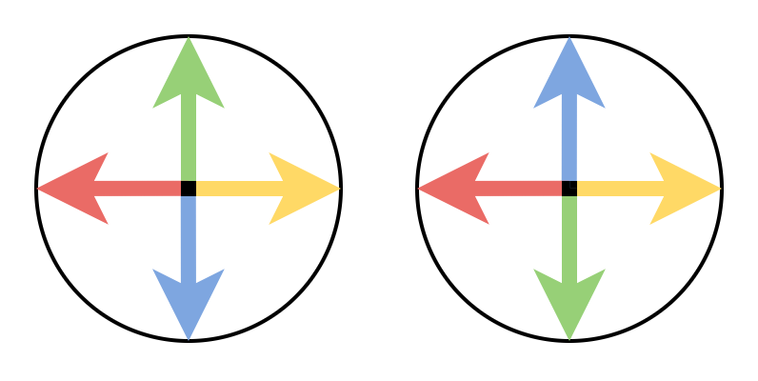
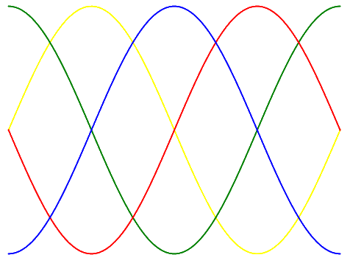
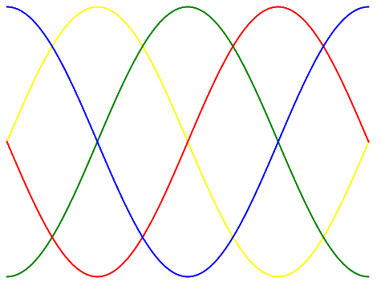
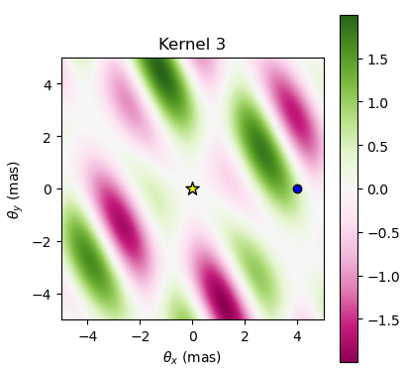
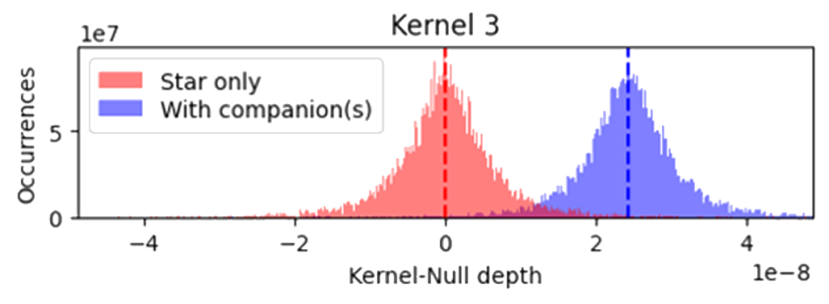
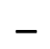
Kernel-Nulling
$$−$$
📚 Martinache & Ireland (2018)
Intensity difference between two symetric phase quadrature combinations
Self-calibrated observable
Showing phase closure characteristics
Robust to first order phase aberration
Anti-symetric transmission map
Vincent Foriel – LIFE 2025
Notes:
KN can be built with more telescopes to be even more efficient
Too much telescopes, the complexity become crazy

Slide 5
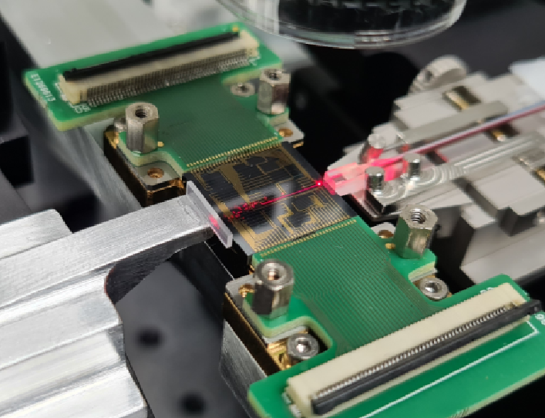
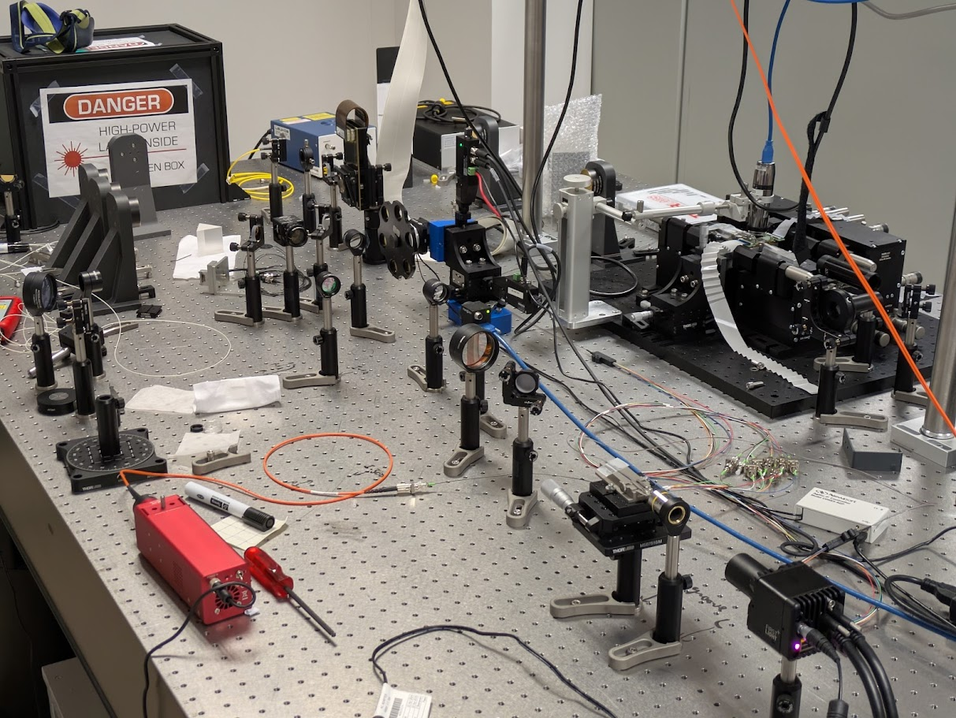
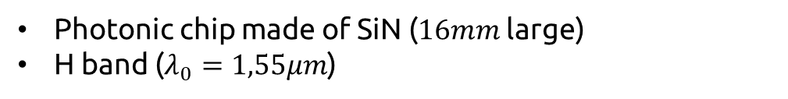
Photonic technology
Photonic chip made of SiN ($16mm$ large)
H band ($λ_{0}=1,55μm$)
Vincent Foriel – LIFE 2025
Notes:
Derived from network and telecommunication (Can operate in 1.65μm --- 1.55 is more affordable)
Photonic still have intrasic phase aberration (manufacturing defects)
Chip has active elements -> tunable architecture

Slide 6
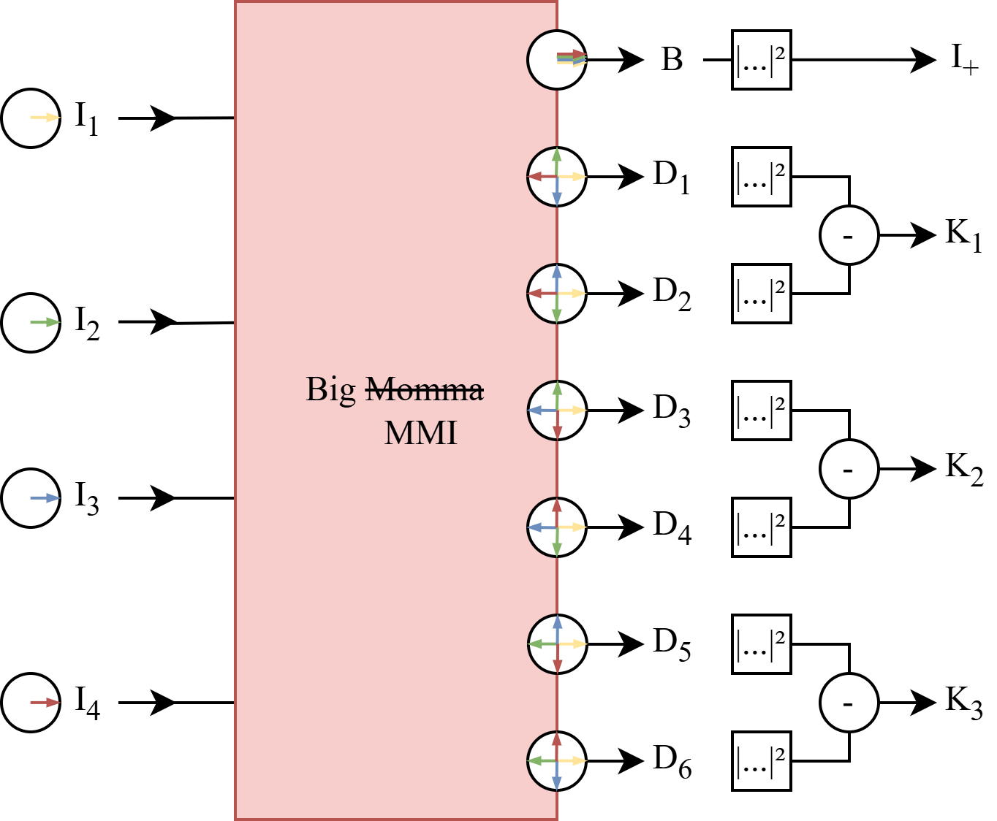
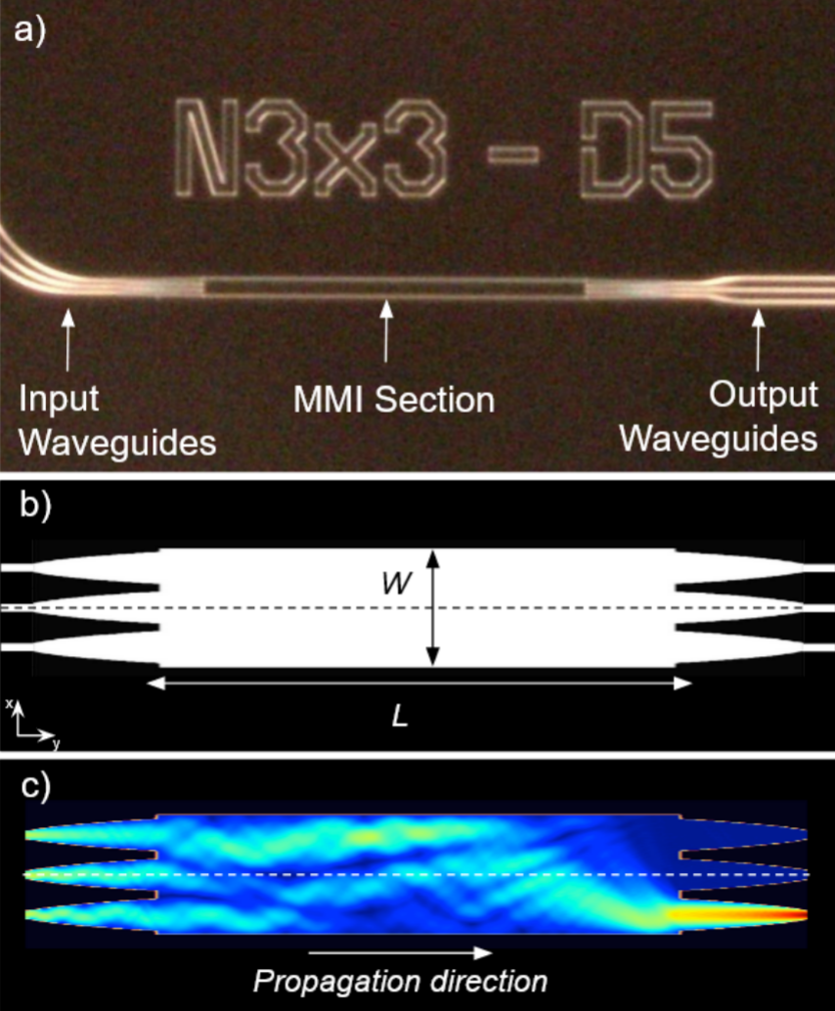
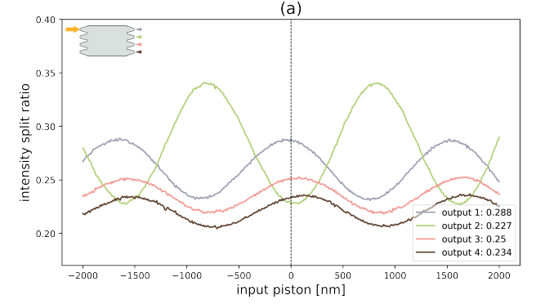
Multi Mode Interferometer (MMI)
Wave propagation simulation in a MMI (Multi Mode Interferometer) 📚 N. Cvetojevic et al. (2022)
Variation of the beam splitting ratio at the outputs of the 4x4 MMI 📚 P. Chingaipe (2024)
Vincent Foriel – LIFE 2025

Slide 7
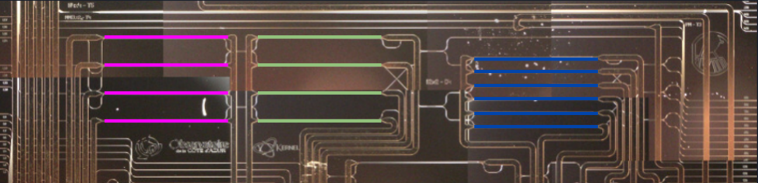
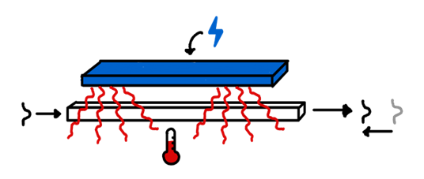
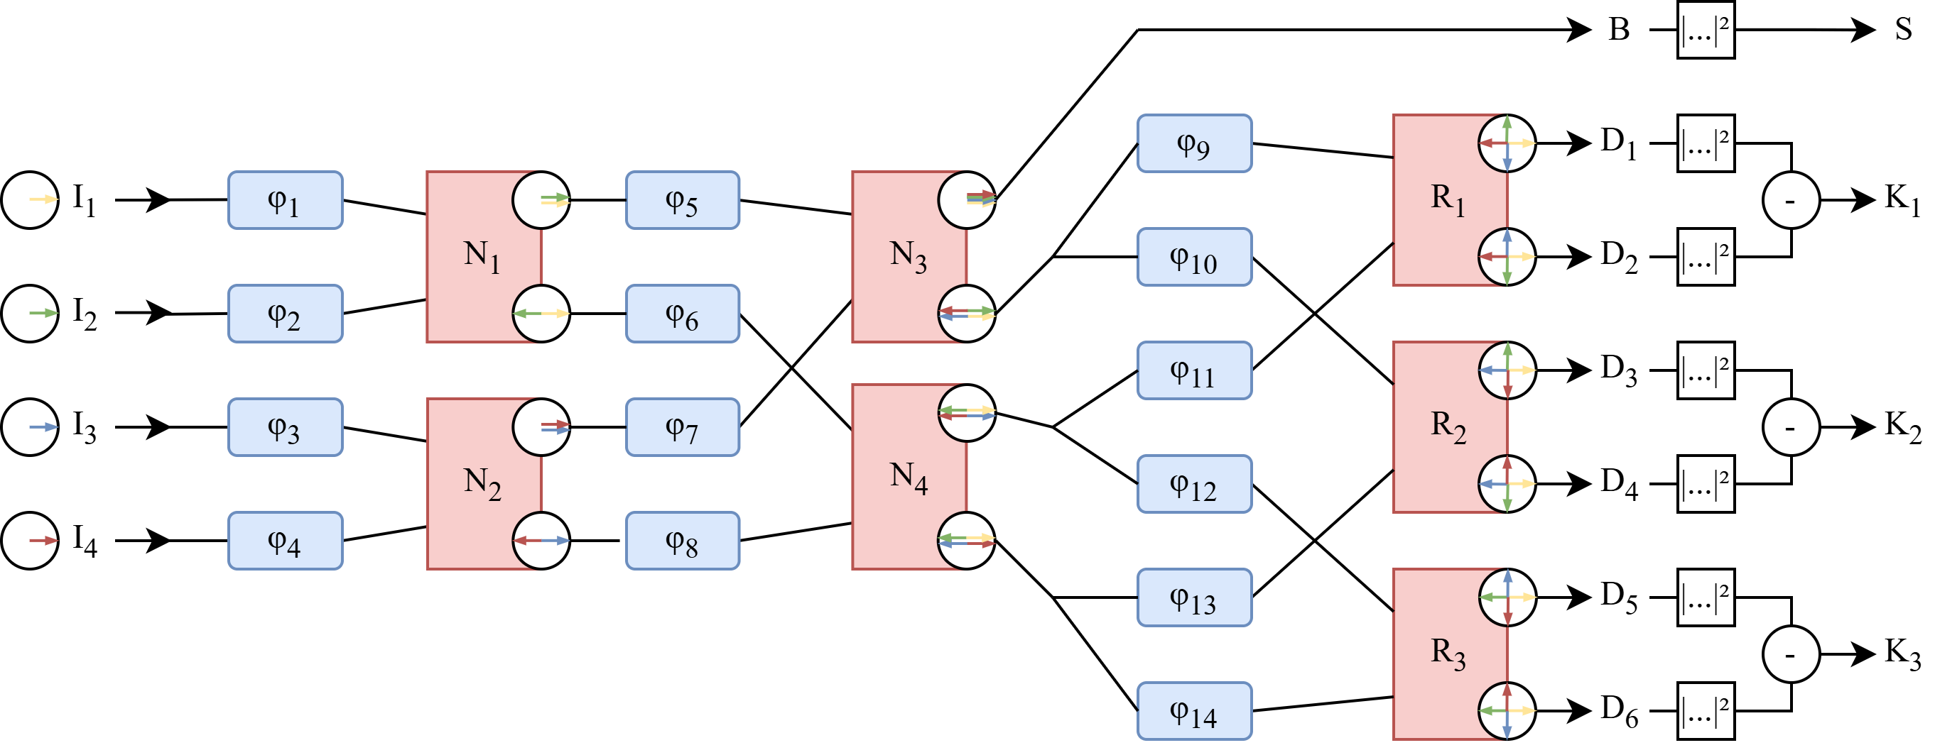
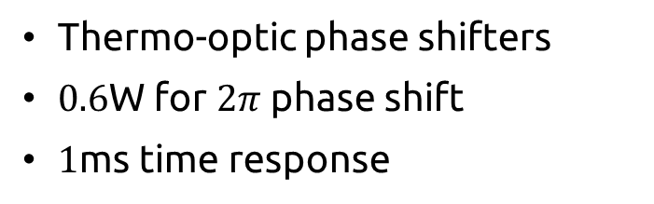
Tunable architecture
Thermo-optic phase shifters
$0.6$W for $2π$ phase shift
$1$ms time response
Vincent Foriel – LIFE 2025
Notes:
Thermo-optic phase shifter – 0,6W for
We decomposed the overall interferometric operation into series of 2x2 MMI
To control the phase at each elementary step of the process
Compensate for intrinsic phase aberration
14-dimension parameter space -> need to be calibrated

Slide 8
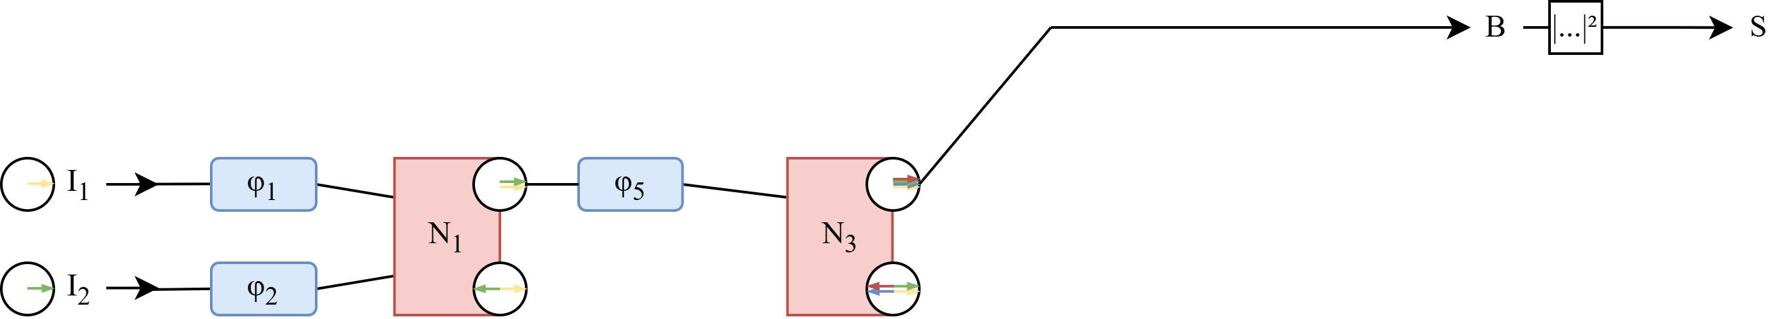
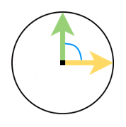
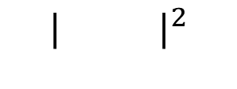
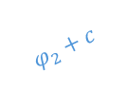
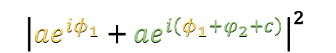
Two calibration approaches
Trial & Error
Add a shift somewhere
Look at the output
Is it better?
Yes: Keep it No: Reject it
Repeat
Obstruction
Isolate one MMI
Tweak input relative phase
Deduce right shift from output response
Do it for all MMI
$$φ_{2}+c$$
$${| |}^{2}$$
$${\left|ae^{iφ_{1}}+ae^{i\left(φ_{1}+φ_{2}+c\right)}\right|}^{2}$$
Vincent Foriel – LIFE 2025
Notes:
Thermo-optic phase shifter – 0,6W for
We decomposed the overall interferometric operation into series of 2x2 MMI
To control the phase at each elementary step of the process
Compensate for intrinsic phase aberration
14-dimension parameter space -> need to be calibrated

Slide 9
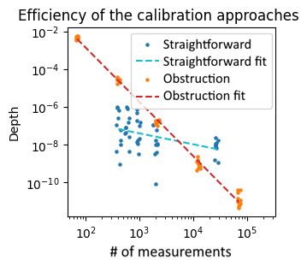
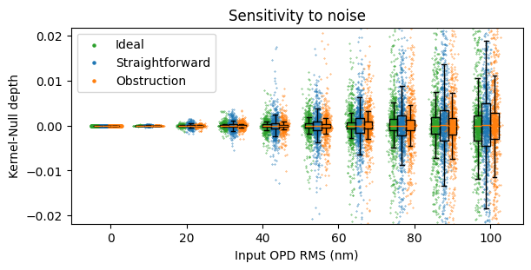
Comparison
Trial & Error
Trial & Error fit
Obstruction
Obstruction fit
Ideal
Trial & Error
Obstruction
?
?
Vincent Foriel – LIFE 2025

Slide 10
Specific statistical test
Vincent Foriel – LIFE 2025

Slide 11
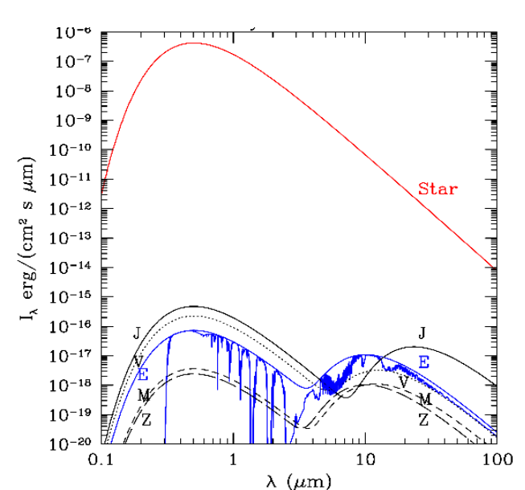
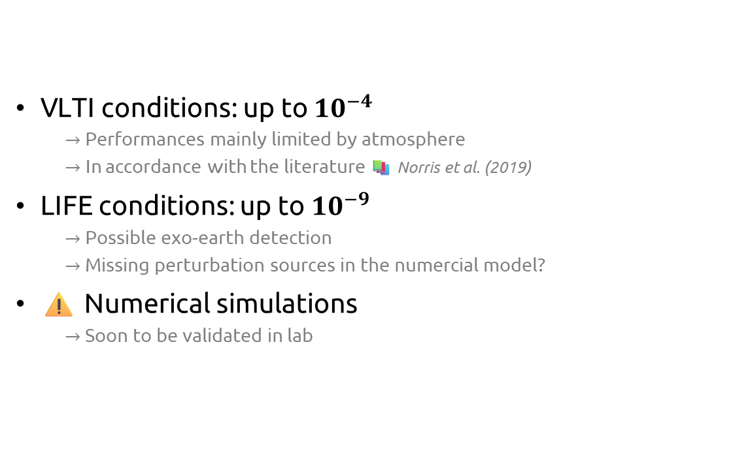
Detection capability
VLTI conditions: up to ${10}^{−4}$
$→$ Performances mainly limited by atmosphere
$→$ In accordance with the literature 📚 Norris et al. (2019)
LIFE conditions: up to ${10}^{−9}$
$→$ Possible exo-earth detection
$→$ Missing perturbation sources in the numercial model?
⚠️ Numerical simulations
$→$ Soon to be validated in lab
VLTI LIFE
SAO model of our solar system 📚 Kaltenegger et al. (2010)
Vincent Foriel – LIFE 2025

Slide 12
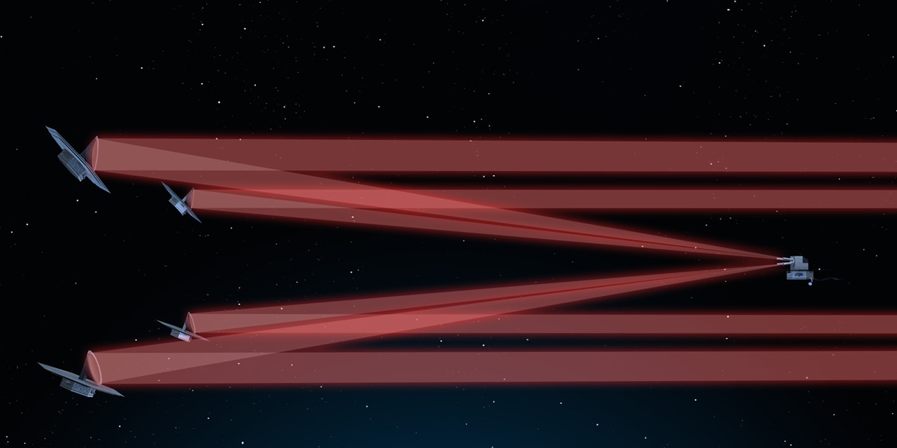
Conclusion
Compact, stable, light
Possibility to make it almost ideal
Future prospects
VLTI ASGARD/NOTT
LIFE
Vincent Foriel – LIFE 2025
Notes:
Conclusion (miniaturization, stability, performance)

Slide 13
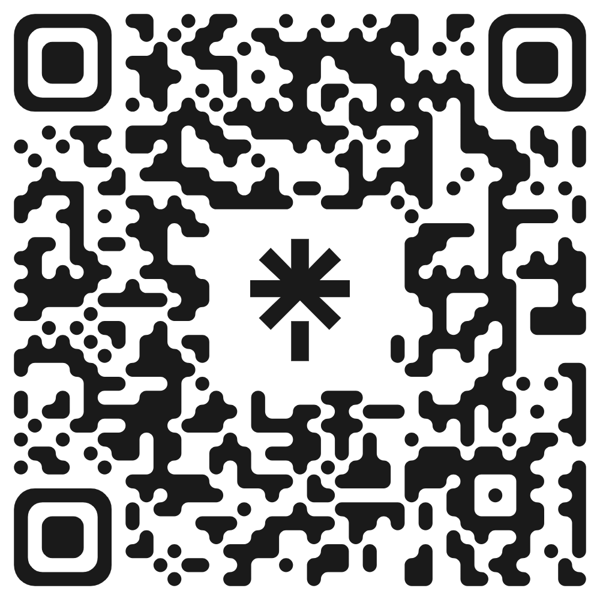
Thank you!
vincent.foriel@oca.eu

Slide 14
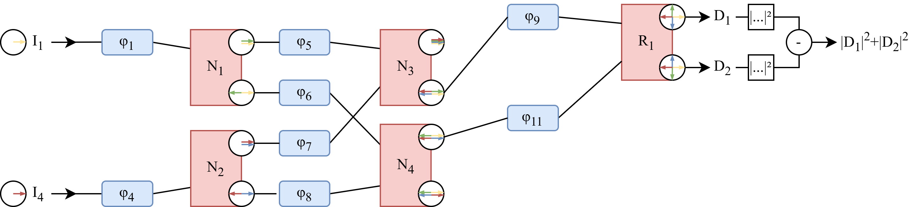
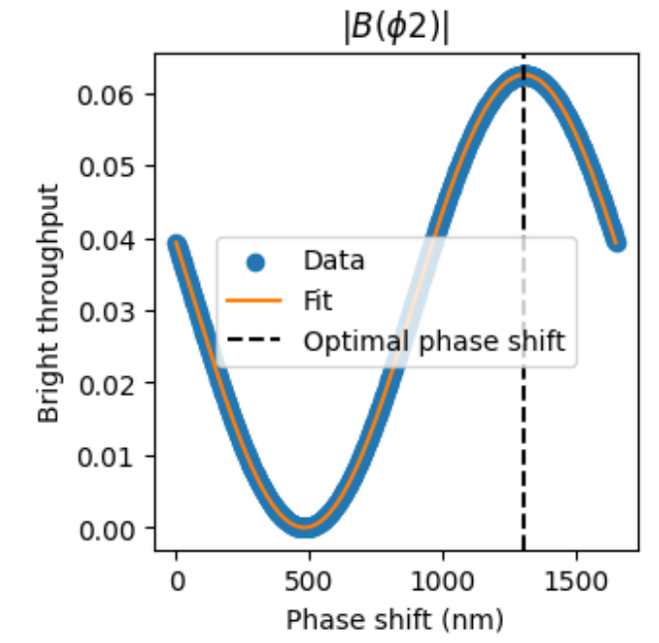
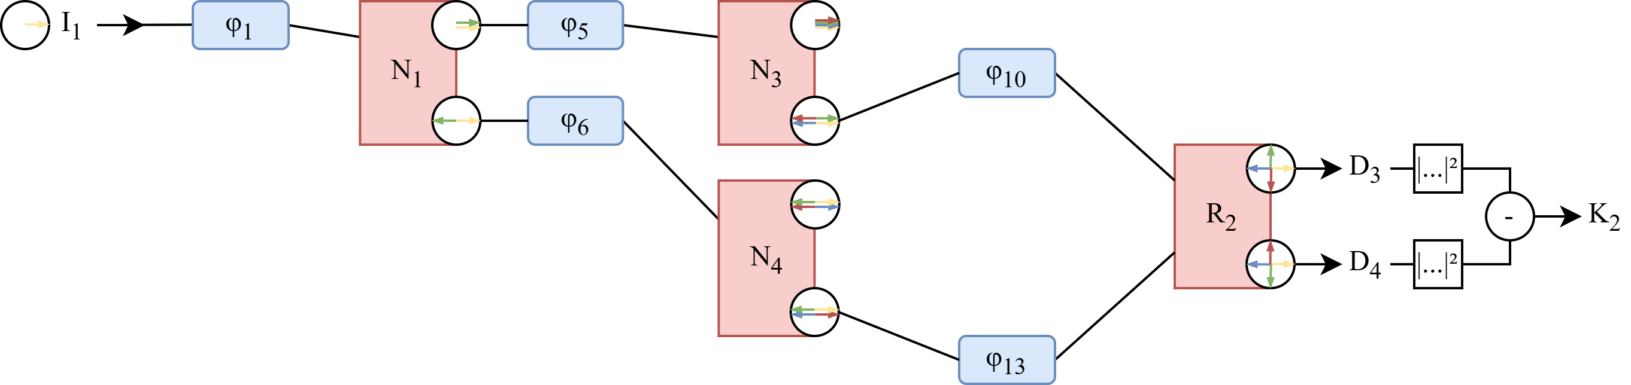
Backup slide Obstruction approach
$$φ_{2}+c$$
Isolate a single MMI
Scan on one shifter
Fit output response
$${| |}^{2}$$
$${\left|ae^{iφ_{1}}+ae^{i\left(φ_{1}+φ_{2}+c\right)}\right|}^{2}$$
Introduction / Materials / Calibration / Results / Conclusion
Vincent Foriel – LIFE 2025

Slide 15
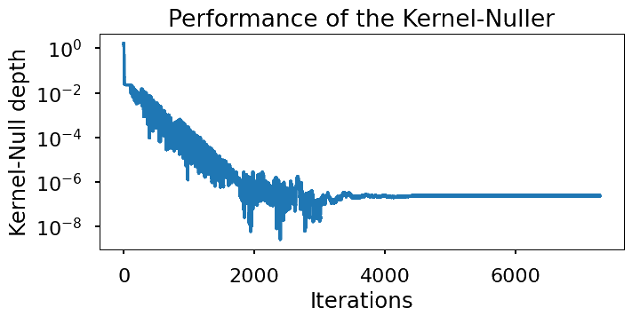
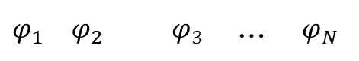
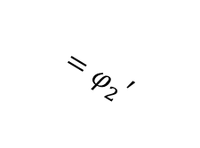
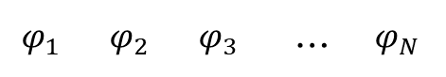

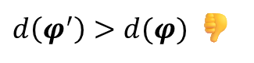
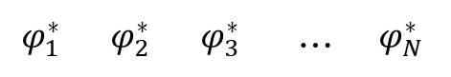
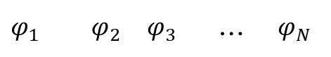
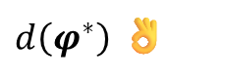
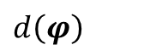
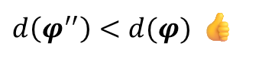

Backup slide Trial & Error approach
Initial
$$φ_{1}$$ | $$φ_{2}$$ | $$φ_{3}$$ | … | $$φ_{N}$$
Measurement
$$d\left(φ\right)$$
Null Depth $d:=\frac{I_{−}}{I_{+}}$ $→$should be minimized
Step 1
❌
$$φ_{1}$$ | $$φ_{2}$$ | $$φ_{3}$$ | … | $$φ_{N}$$
$d\left(φ^{′}\right)>d(φ)$ 👎
$$+Δφ$$
Step 2
✔️
$$φ_{1}$$ | $$φ_{2}$$ | $$φ_{3}$$ | … | $$φ_{N}$$
$d\left(φ^{′′}\right)<d(φ)$ 👍
$$+Δφ$$
$$=φ_{2}′$$
…
Final
$$φ_{1}^{∗}$$ | $$φ_{2}^{∗}$$ | $$φ_{3}^{∗}$$ | … | $$φ_{N}^{∗}$$
$d\left(φ^{∗}\right)$ 👌
Introduction / Materials / Calibration / Results / Conclusion
Vincent Foriel – LIFE 2025

Slide 16
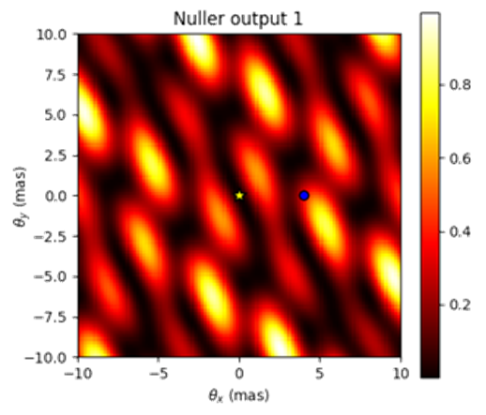
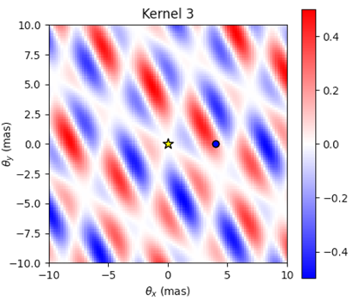
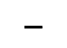
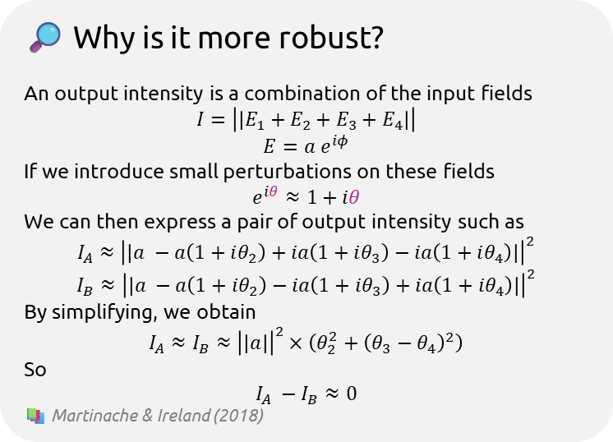
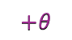


Backup slide Kernel-Nulling
🔎 Why is it more robust?
An output intensity is a combination of the input fields
$$I=\left|\left|E_{1}+E_{2}+E_{3}+E_{4}\right|\right|$$
$$E=a e^{iφ}$$
If we introduce small perturbations on these fields
$$e^{iθ}≈1+iθ$$
We can then express a pair of output intensity such as
$$I_{A}≈{\left|\left|a −a\left(1+iθ_{2}\right)+ia\left(1+iθ_{3}\right)−ia\left(1+iθ_{4}\right)\right|\right|}^{2}$$
$$I_{B}≈{\left|\left|a −a\left(1+iθ_{2}\right)−ia\left(1+iθ_{3}\right)+ia\left(1+iθ_{4}\right)\right|\right|}^{2}$$
By simplifying, we obtain
$$I_{A}≈I_{B}≈{\left|\left|a\right|\right|}^{2}×\left(θ_{2}^{2}+{\left(θ_{3}−θ_{4}\right)}^{2}\right)$$
So
$$I_{A} −I_{B}≈0$$
📚 Martinache & Ireland (2018)
📚 Martinache & Ireland (2018)
$$−$$
$${\left|ae^{iφ_{1}}+ae^{i\left(φ_{1}+\frac{π}{2}\right)}+ae^{i\left(φ_{1}+π\right)}+ae^{i\left(φ_{1}+\frac{3π}{2} \right)}\right|}^{2} − {\left|ae^{iφ_{1}}+ae^{i\left(φ_{1}+\frac{π}{2} \right)}+ae^{i\left(φ_{1}+π\right)}+ae^{i\left(φ_{1}+\frac{3π}{2}\right)}\right|}^{2}$$
$$=0$$
$$+θ$$
$$+θ$$
For $θ≪π$, such as $e^{iθ}≈1+θ$

Slide 17



Backup slide MMI: Multi Mode Interferometer
Self-imaging multi mode waveguide
Wave propagation simulation in a MMI cavity 📚 Cvetojevic et al. (2022)
Operation defined by the length $L$
🔎 How does it work?
A single-mode light entering a multimode region will excite several transverse modes that will interfere. These interferences will produce an image of the input at specific positions: $L_{π}$, $L_{π}/2$, $L_{π}/3$, ...
$$L_{π}=\frac{4n_{eff}W^{2}}{3λ}$$
🤔 What is a mode?
In a waveguide (fiber optics), the light doesn’t propagate freely, it is constrained between the borders. Like a guitar string that vibrates when pinched on both sides, the light wave can only take specific shapes that respect theses constraints.
Monomode fiber
Multimode fiber

Slide 18


Backup slide Thermo-optic phase shifters
Recipe:
Electric resistance
⤷ Heat
⤷ Optical index modification
⤷ Phase delay
🔎 What’s the physics behind?
In a material, the light speed is defined such as
$$v=\frac{c}{n}$$
The refractive index $n$ is related to the material’s polarizability and its electronic band structure. When the temperature increases:
Thermal vibrations (phonons) increase → atomic bonds become more flexible → the electronic response to an electromagnetic field is modified.
This affects the dielectric permittivity $ε$, hence $\sqrt{εμ}$​ (with $μ≈1$ for non-magnetic optical materials).
The broadening of electronic transitions or absorption bands can also modify $n\left(λ\right)$, according to Sellmeier dispersion.
There is no universal exact expression of $n\left(λ,T\right)$. However, we empirically use the following linear approximation which is valid for small temperature variation:
$$n\left(λ,T\right)=n_{0}\left(λ\right)+\frac{dn\left(λ\right)}{dT}\left(T−T_{0}\right)$$
Were $T_{0}$ is the reference temperature (typically $300K$) 📚 Wikipedia
Response time ~ 1 μs
Phase range > 2λ

Slide 19



Backup slide Output data analysis
Kernel outputs follows an unknown distribution
Companions affect this distribution
In practice, SNR << 1
Searching for most efficient specific statistical test

